Slide 1
TEAM NUMBER – 12
TEAM NAME – FOURCASTERS
FULL NAME | CLASS ROLL NO. | AUTONOMY ROLL NO.
ANANYA ARYA | 2262032 | 12622019007
DHRUV JAIN | 2262016 | 12622019020
KANHAIYA YADAV | 2262028 | 12622019026
SABYASACHI SINHA | 2262027 | 12622019045

Slide 2
PROBLEM STATEMENT :
SANKET –
A Computer Vision based solution for hearing-impaired to detect sign language and convert it into readable form.

Slide 3
OBJECTIVES :
Detect static letters, digits, and words (done in previous demos)
Detect dynamic letters, digits, words, and sentences

Slide 4
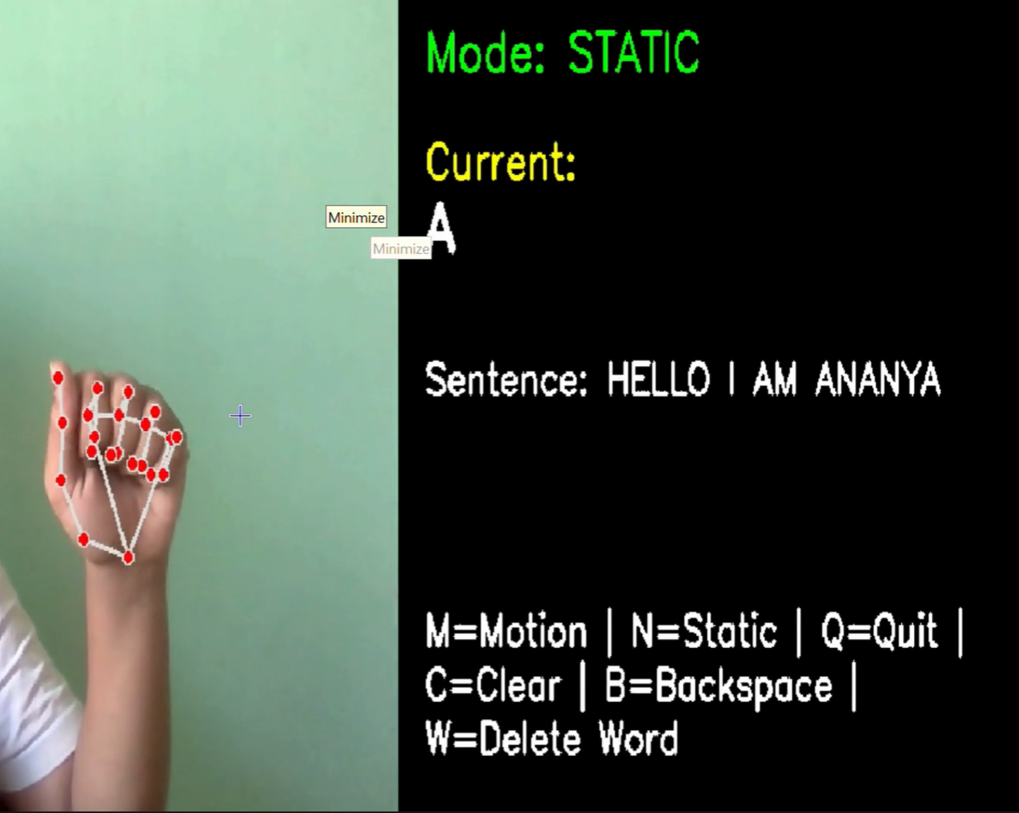
MAIN PROGRESS
At the end of last semester, our model was recognizing most static images of letters, digits and some words.
We have been able to detect dynamic letters, digits, words, sentences which use only one hand for signing. A person can stand in front of the camera and sign (using one hand) any message, the desired output will be displayed.

Slide 5
What we will demonstrate in the final demonstration…
A working interface which allows user to sign whatever they wish and for an appropriate message to be displayed.
Text to speech converter so that people who cannot hear well can read the message

Slide 6
Individual Contributions
Sabyasachi Sinha – Literature Research, Frame Capturing, Feature Extraction, Object Tracking
Kanhaiya Yadav – UI development, Frame Capturing, Feature Extraction, Object tracking
Dhruv Jain – Architecture Design, Model training and testing
Ananya Arya – Synthetic Data Curation, Model training and testing

Slide 7


